Slide 1



Slide 2
介紹電腦繪圖應用的簡例
電腦繪圖系統的組成
電腦繪圖發展歷史

Slide 3

Computer graphics deals with all aspects of creating images with a computer
  Hardware
  Software
  Applications

Slide 4


Where did this image come from?
What hardware/software did we need to produce it?

Slide 5

Application: The object is an artist’s rendition of the sun for an animation to be shown in a planetarium
Software: Maya for modeling and rendering but Maya is built on top of OpenGL
Hardware: PC with graphics card for modeling and rendering

Slide 6

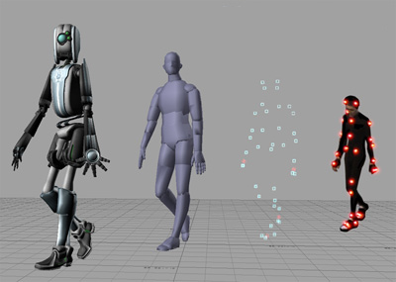
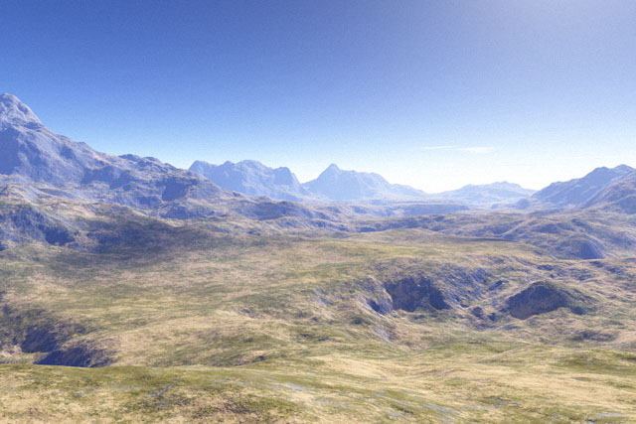

Slide 7

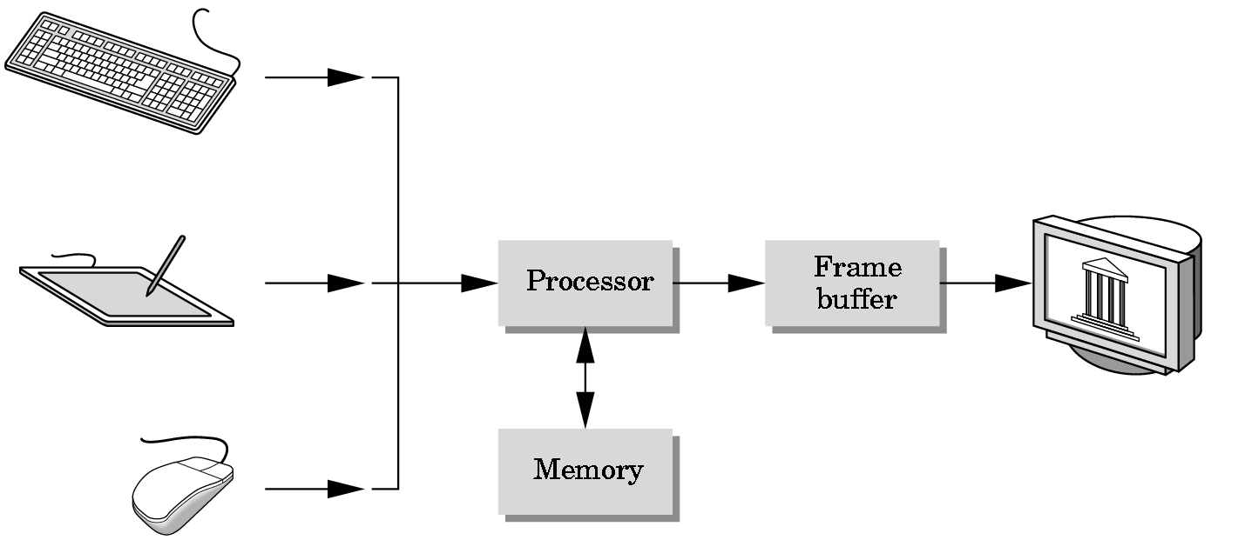
Input devices
Output device
Image formed in FB

Slide 8

Almost all graphics systems are raster based
A picture is produced as an array (raster) of pixels
The pixels are stored in a part of memory called as frame buffer
Renamed as color buffer
Holds far more information such as depth information (precision) needed for creating images (the number of bits that are used for each pixels)

Slide 9
The conversion of geometric entities to pixel colors and location in the frame buffer is known as rasterization or scan conversion in computer graphics.
Today, graphic processing units (GPUs) work for this conversion
A raster graphics image or bitmap is a data structure representing a generally rectangular grid of pixels

Slide 10

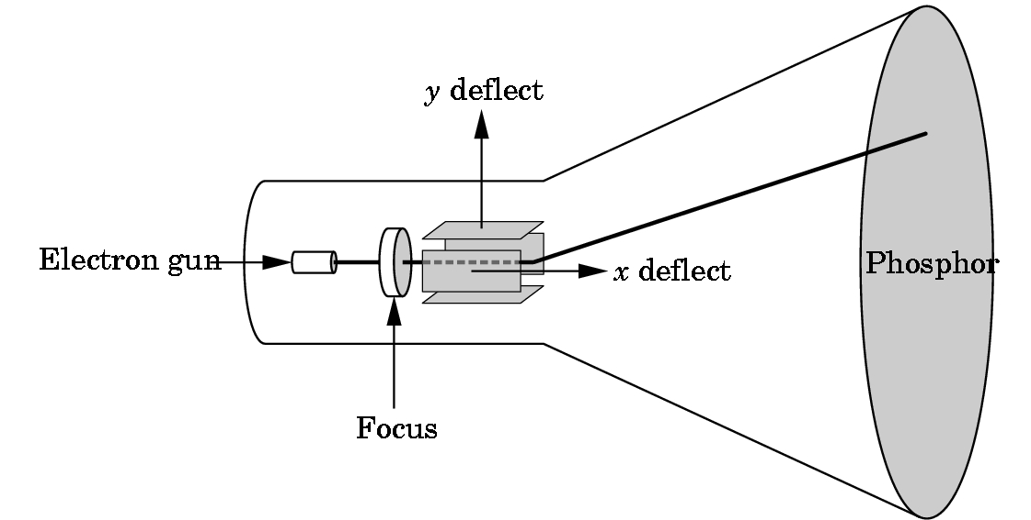
In the early, the dominant type of display or monitor has been the cathode ray tube (CRT)

Slide 11

In the raster system, the graphics system take pixels to display them as points on the surface of the display in two fundamental ways.
Noninterlaced or progressive display, the pixels are displayed row by row or scan line by line.
Interlaced display, refresh odd rows and even rows alternately.

Slide 12

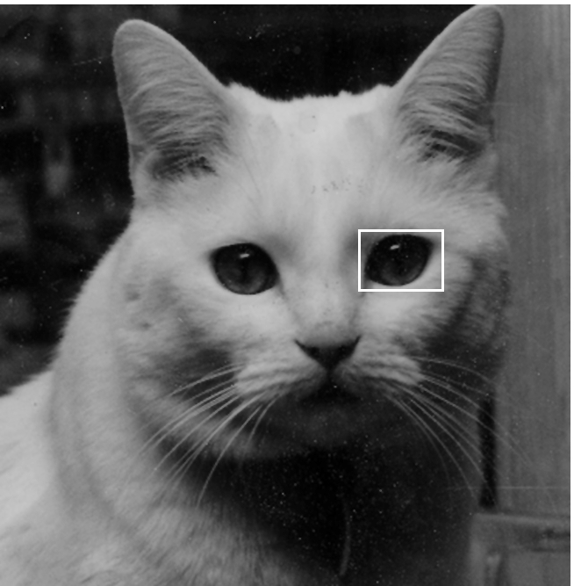
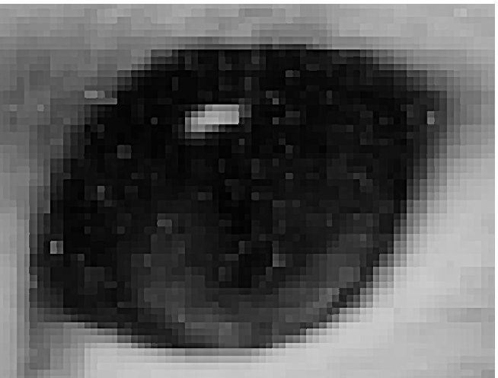
Image produced as an array (the raster) of picture elements (pixels) in the frame buffer
Resolution ─ The number of pixels in the frame buffer
Depth/Precision ─ The number of bits that are used for each pixel.

Slide 13

Computer graphics goes back to the earliest days of computing
  Strip charts
  Pen plotters
  Simple displays using A/D converters to go from computer to calligraphic CRT
Cost of refresh for CRT too high
  Computers slow, expensive, unreliable

Slide 14

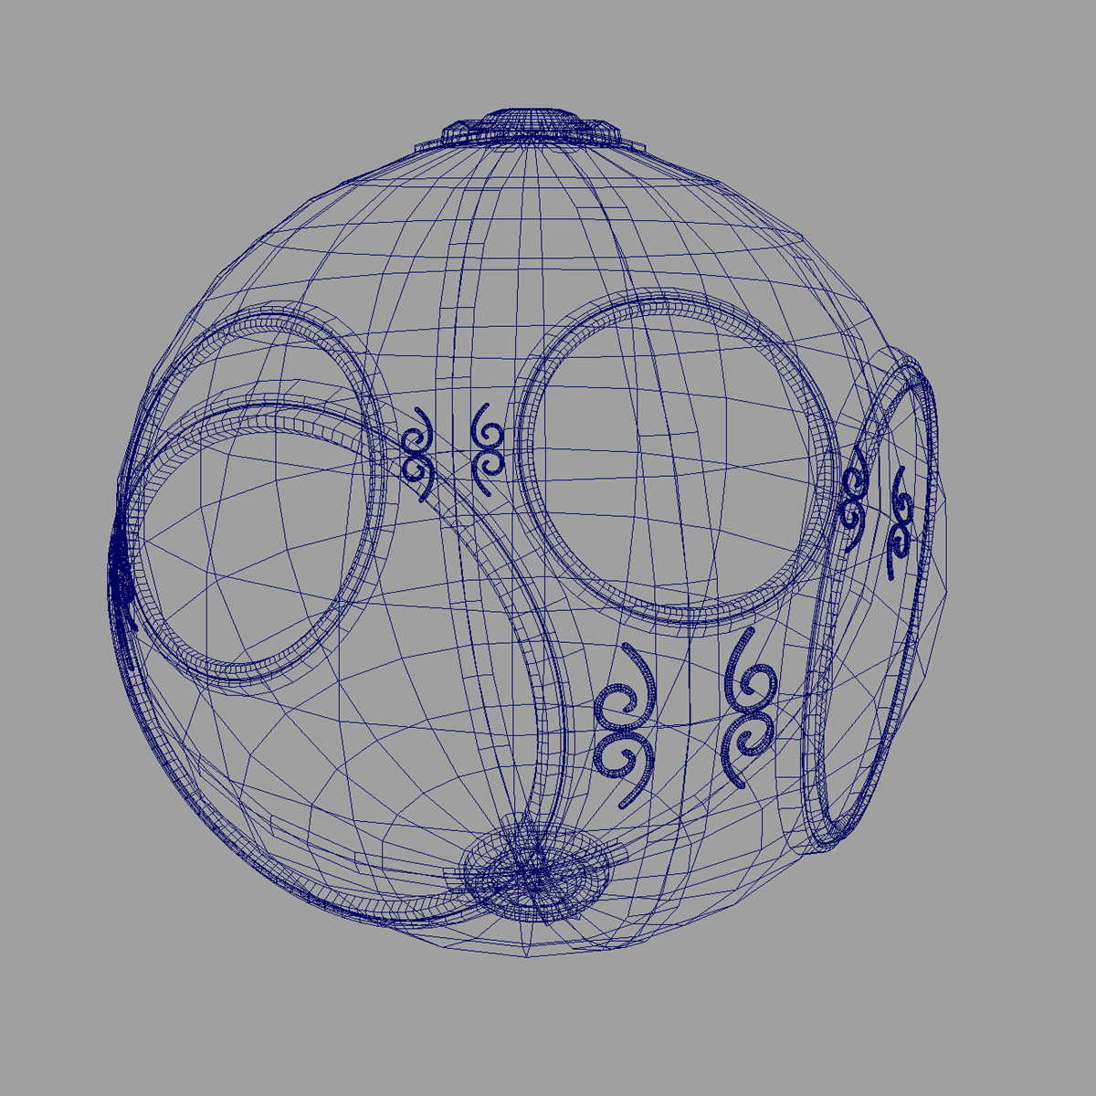
Wireframe graphics
  Draw only lines
Display Processors
Wireframe representation

Slide 15

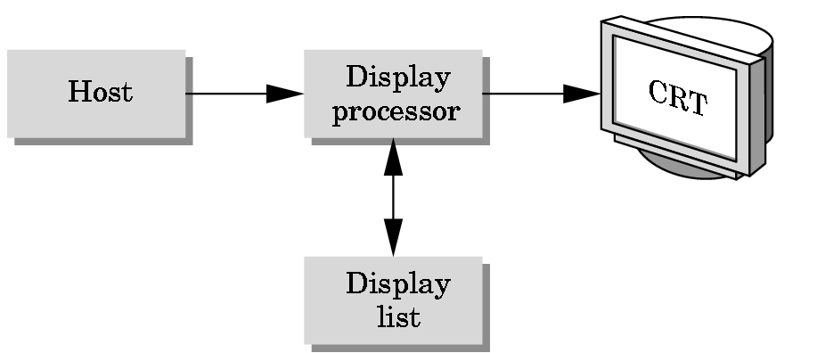
Rather than have the host computer try to refresh display use a special purpose computer called a display processor (DPU)
Graphics stored in display list (display file) on display processor
Host compiles display list and sends to DPU

Slide 16

Raster Graphics
Beginning of graphics standards
  IFIPS
    GKS: European effort
      Becomes ISO 2D standard
    Core: North American effort
      3D but fails to become ISO standard
Workstations and PCs

Slide 17

Although we no longer make the distinction between workstations and PCs, historically they evolved from different roots
  Early workstations characterized by
    Networked connection: client-server model
    High-level of interactivity
  Early PCs included frame buffer as part of user memory
    Easy to change contents and create images

Slide 18




Realism comes to computer graphics
smooth shading
environment
mapping
bump mapping

Slide 19
Special purpose hardware
  Silicon Graphics geometry engine
    VLSI implementation of graphics pipeline
Industry-based standards
  PHIGS
  RenderMan
Networked graphics: X Window System
Human-Computer Interface (HCI)

Slide 20

OpenGL API
Completely computer-generated feature-length movies (Toy Story) are successful
New hardware capabilities
  Texture mapping
  Blending
  Accumulation, stencil buffers (a special color buffer or frame buffer)

Slide 21

Photorealism (相片擬真)
Graphics cards for PCs dominate market
  Nvidia, ATI
Game boxes and game players determine direction of market
Computer graphics routine in movie industry: Maya, Lightwave

